Slide 1

Image Deblurring Using Knowledge Distillation
A Teacher-Student Model for Image Sharpening
S. Sabilah • M. Vishwanathan • Syed Thufel Syed Wahid
B.Tech AI & DS, B.S. Abdur Rahman Crescent Institute of Science and Technology

Slide 2
Introduction to Image Deblurring
The Problem
Our Solution
Image blurring is a pervasive issue in photography and computer vision, often resulting from camera motion, lens defocus, or low-light conditions. These factors degrade image quality, obscuring fine details and impeding subsequent analyses such as object recognition or medical diagnosis.
We propose a deep learning approach to restore high-quality, sharp images from their blurred counterparts. Our method leverages a lightweight student Convolutional Neural Network (CNN) trained through knowledge distillation, complemented by a teacher model and a sophisticated loss function designed to preserve intricate details and edges.

Slide 3
Dataset and Preprocessing
GoPro Dataset
Preprocessing Steps
The GoPro dataset serves as the backbone for our training, offering pairs of blurred and sharp images. This dataset is renowned for its diverse scenarios and high-fidelity ground truth, crucial for supervised deblurring tasks.
To ensure consistent input for our models,
all images undergo a standardised preprocessing pipeline:
Resize: Images are uniformly resized to a resolution of 256x256 pixels.
blur/: Contains original blurry images.
Conversion: Images are converted to PyTorch Tensors,
optimising them for neural network processing.
sharp/: Features corresponding ground truth sharp images.
blur_gamma/: Includes gamma-corrected blurry images, vital for the teacher model's input.

Slide 4



Teacher-Student Framework for Deblurring
Teacher Model
Student Model
Training Approach
Fake MAXIM: A precomputed model that generates pseudo-sharp images from blur_gamma inputs. This teacher provides initial guidance for the student, distilling complex deblurring knowledge.
Deep CNN (StudentCNN_v3): Our custom-designed lightweight convolutional neural network, specifically engineered for efficient deblurring and real-time inference.
A dual training strategy combining knowledge distillation from the teacher and supervised training with ground truth sharp images, enhancing robustness and generalisation.

Slide 5
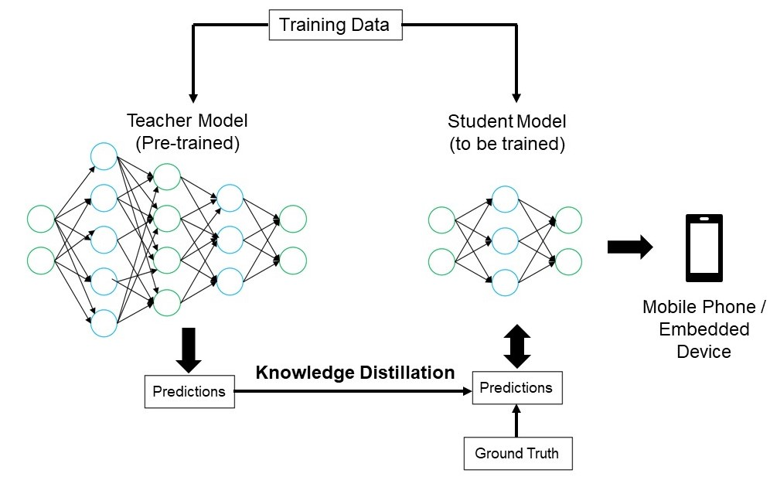
StudentCNN_v3 Architecture
Key Features
Encoder-Decoder CNN: Extracts features and reconstructs the image.
Residual Blocks: Facilitate deeper networks and improve gradient flow.
Skip Connections: Preserve fine details and aid in high-resolution reconstruction.
Downsampling & Upsampling: Efficiently process features at various scales.
Advantages
Lightweight: Optimised for fast inference, ideal for real-time applications.
Edge Preservation: Designed to recover sharp edges and fine textures.

Slide 6



Sophisticated Loss Functions
Mean Squared Error (MSE)
Multi-Scale SSIM (MS-SSIM)
Edge-Aware Loss
Quantifies the pixel-wise difference between the predicted and ground truth images, driving the model to minimise overall reconstruction error.
Utilises Sobel filters to explicitly penalise blurring around edges, ensuring the sharpened output maintains crisp boundaries and fine details.
Evaluates structural similarity across multiple resolutions, capturing perceptual quality aspects such as luminance, contrast, and structure.
This combined loss function ensures a balance between pixel accuracy, perceptual quality, and critical edge fidelity.

Slide 7
Training Details and Metrics
Training Configuration
Evaluation Metrics
Epochs: 30 iterations over the entire dataset.
PSNR (Peak Signal-to-Noise Ratio): Measures the reconstruction quality based on pixel differences, with higher values indicating better quality.
Batch Size: 2 images per training step.
Optimizer: Adam, with a learning rate of 1e-4 for efficient convergence.
SSIM (Structural Similarity Index): Assesses perceived image quality, considering luminance, contrast, and structural similarities. Values range from -1 to 1, with 1 being perfect similarity.
Device: CUDA-enabled GPU, leveraging parallel processing for faster training.
MS-SSIM (Multiscale SSIM): An advanced version of SSIM that evaluates similarity across multiple scales, providing a more comprehensive perceptual quality assessment.

Slide 8
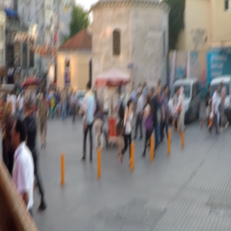
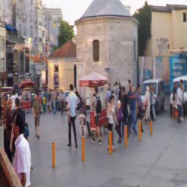
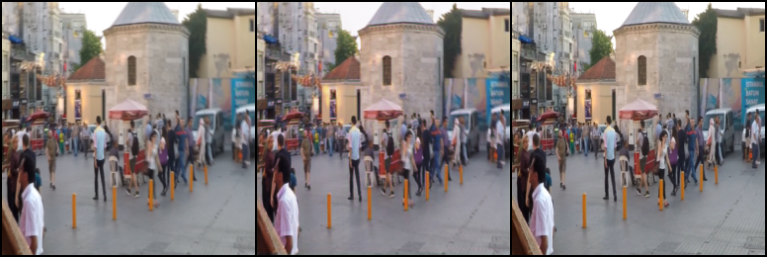
Results and Future Directions
Visual Output
Future Work
Real MAXIM Integration: Incorporate a real MAXIM model as the teacher to further enhance the student's deblurring capabilities.
Mobile Deployment Optimisation: Refine the student model for deployment on mobile devices, enabling real-time deblurring in portable applications.
Higher Resolution Fine-tuning: Adapt and fine-tune the model to effectively handle and produce higher resolution deblurred images.
INPUT OUTPUT
Our model demonstrates significant sharpening and detail recovery, evident in the visual comparison between the blurred input, our sharpened output, and the ground truth. Fine textures and edges are noticeably enhanced, proving the efficacy of our approach.

